Slide 1
Emerging trends in software engineering
COMP6100001 - Software engineering
Session 26
Kenny Jingga, S.Kom., M.T.

Slide 2
Session 26 – Emerging trends in software engineering
Learning objectives
At the end of this session, students will be expected to be able:
Explain how emerging technologies influence software engineering practices and ethics
Analyze the potential impact of future technologies on software processes, roles, and responsibilities

Slide 3
Session 26 – Emerging trends in software engineering
Content outline
Technology Evolution
Software Engineering as a Discipline
Observing Software Engineering Trends
Identifying “Soft Trends”
Technology Directions
Cloud Computing and Serverless Architectures
Artificial Intelligence (AI) and Machine Learning (ML) in Software Development
Blockchain Technology and Its Applications
Quantum Computing Basics

Slide 4
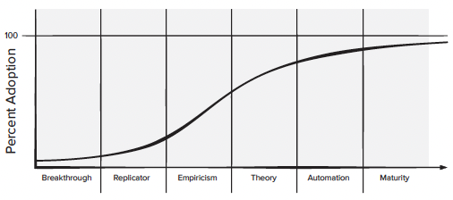
Technology Evolution
The big questions for the twenty-first century are:
  (1) How rapidly does a technology evolve?
  (2) How significant are the effects of positive feedback?
  (3) How profound will the resultant changes be?

Slide 5
Software Engineering as a Discipline
As mobility begins to dominate the software landscape, Shaw identifies challenges that “emerge from the deep interdependencies between very complex systems and their users”. She argues that the knowledge base that leads to “purposeful practice” has been democratized by the specialized social networks that now populate the Web.
“Problems facing software engineers are increasingly situated in complex social contexts and delineating the problem’s boundaries is increasingly difficult”.
As a consequence, isolating the scientific underpinnings of a discipline remains a challenge.
At this point in the history of our field, it is reasonable to state that “the discovery of new software engineering ideas is, by now, naturally incremental and evolutionary”

Slide 6
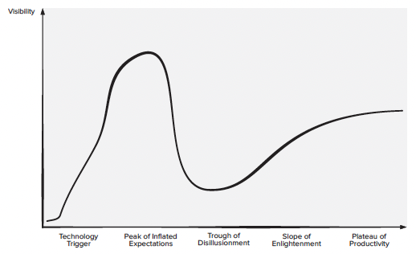
Observing Software Engineering Trends
Barry Boehm suggests that “software engineers [will] face the formidable challenges of dealing with rapid change, uncertainty and emergence, dependability, diversity, and interdependence, but they also have opportunities to make significant contributions that will make a difference for the better.” But what are the trends that will enable you to face these challenges in the years ahead?

Slide 7
Identifying “Soft Trends”
Connectivity and collaboration (enabled by high-bandwidth communication) has already led to software teams that do not occupy the same physical space (telecommuting and part-time employment in a local context)
Globalization leads to a diverse workforce (in terms of language, culture, problem resolution, management philosophy, communication priorities, and person-toperson interaction)

Slide 8
Managing Complexity
In the early days, software engineers attempted to manage complexity in what can only be described as an ad-hoc fashion
Now, we use process, methods, and tools to keep complexity under control. But tomorrow? Is our current approach up to the task?
In the future, we are likely to see wider use of artificial intelligence techniques to help software engineers manage these levels of complexity [Har12b], [Xie18]
Machine learning is one such technique that can help with testing and bug fixing [Mei18]
Data science techniques can be used to help make sense of the vast amount of software engineering data generated by these large projects [Kim16b]
Mining of these repositories is becoming an accepted research technique in the software engineering communities [Dye15]

Slide 9
Open-world software
Concepts such as ambient intelligence, context-aware applications, and pervasive/ubiquitous computing all focus on integrating software-based systems into an environment far broader than a laptop, a mobile computing device, or any other digital device.
“open-world software”—software that is designed to adapt to a continually changing environment “by self-organizing its structure and self-adapting its behavior”

Slide 10
Open source
The “open source” movement has been described in the following manner: “Open source is a development method for software that harnesses the power of distributed peer review and transparency of process. The promise of open source is better quality, higher reliability, more flexibility, lower cost, and an end to predatory vendor lock-in.”
The term open source, when applied to computer software, implies that software engineering work products (models, source code, test suites) are open to the public and can be reviewed and extended (with controls) by anyone with interest and permission.

Slide 11
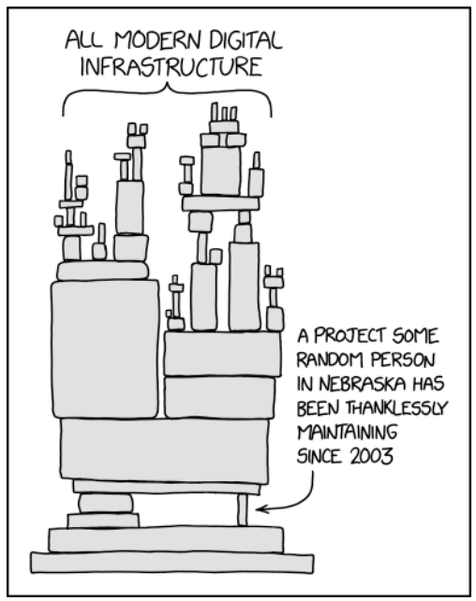
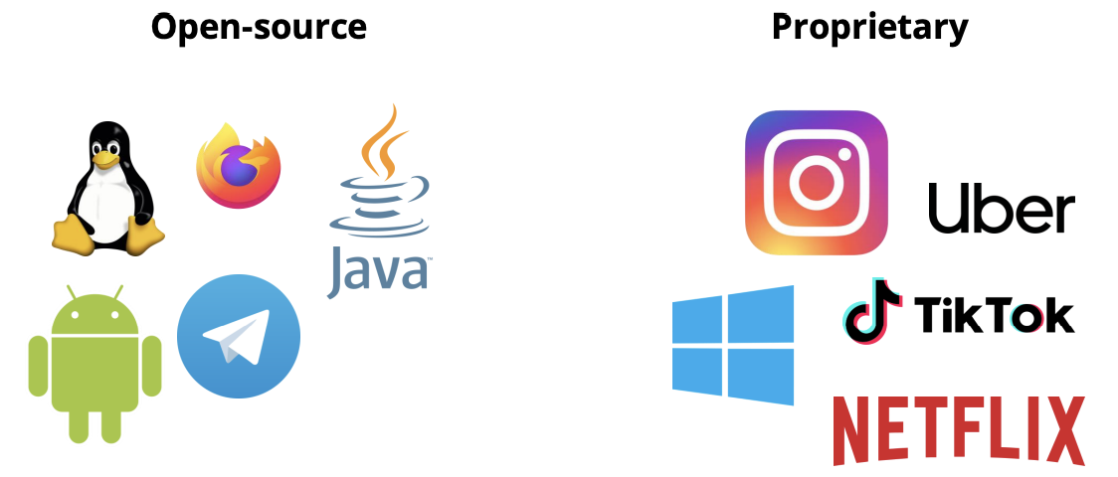
Open source
What is open-source software?

Slide 12
Technology direction
Software engineering is about far more than technology—it’s about people and their ability to communicate their needs and innovate to make those needs a reality
Whenever people are involved, change occurs slowly in fits and starts
It’s only when a “tipping point” is reached that a technology cascades across the software engineering community and broad-based change truly does occur

Slide 13
Process trends
Six ideas proposed to suggest possible process trends:
  As Software Process Improvement (SPI) frameworks evolve, they will emphasize “strategies that focus on goal orientation and product innovation”
  Because software engineers have a good sense of where the process is weak, process changes should generally be driven by their needs and should start from the bottom up
  Automated software process technology (SPT) will move away from global process management (broad-based support of the entire software process) to focus on those aspects of the software process that can best benefit from automation
  Greater emphasis will be placed on the return on investment of SPI activities
  As time passes, the software community may come to understand that expertise in sociology and anthropology may have as much or more to do with successful SPI as other, more technical disciplines
  New modes of learning may facilitate the transition to a more effective software process

Slide 14
The grand challenge
As the software engineering community develops new model-driven approaches to the representation of system requirements and design, the following characteristics must be addressed:
  Multifunctionality
  Reactivity and timeliness
  New modes of user interaction
  Complex architectures
  Heterogeneous, distributed systems
  Criticality
  Maintenance variability

Slide 15
Cloud Computing and Serverless Architectures
Introduction to cloud computing
Cloud Computing has revolutionized the way software applications are developed, deployed, and managed. It offers scalable resources, cost-efficiency, and flexibility, enabling organizations to focus on core competencies without worrying about underlying infrastructure.
Key Concepts:
Definition: Delivery of computing services over the internet (“the cloud”) including storage, processing, and networking.
Benefits: Scalability, cost-efficiency, flexibility, reliability, and global reach.
Deployment Models: Public, Private, Hybrid, and Community Clouds.

Slide 16
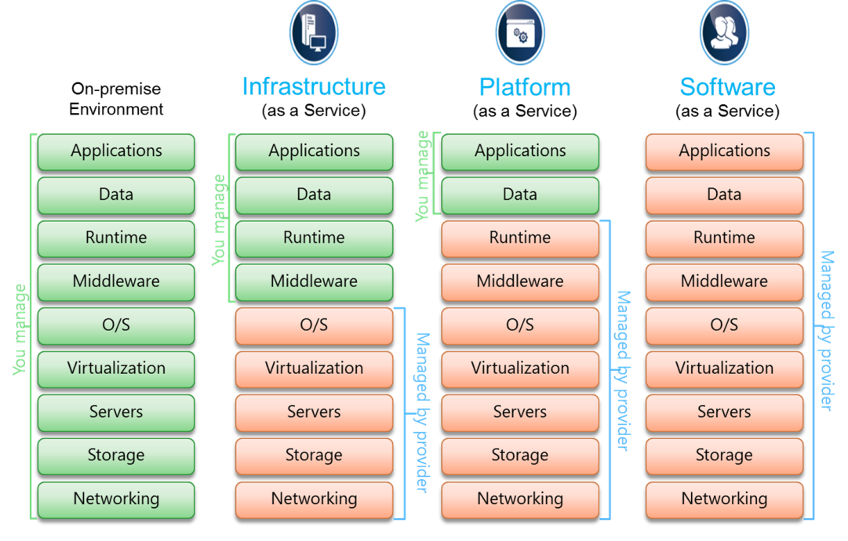
Cloud Computing and Serverless Architectures
Cloud services models
Cloud service models define the level of control, flexibility, and management provided to the user. Understanding these models is crucial for selecting the appropriate services for specific application needs.
The models:
Infrastructure as a Service (IaaS). Examples: Amazon Web Services (AWS) EC2, Microsoft Azure Virtual Machines, Google Compute Engine (GCE)
Platform as a Service (PaaS). Examples: Google App Engine, Microsoft Azure App Service, Heroku
Software as a Service (SaaS). Examples: Google Workspace, Microsoft Office 365, Salesforce

Slide 17
Cloud Computing and Serverless Architectures
Serverless Computing
Serverless Computing abstracts server management, allowing developers to focus solely on writing code. It provides a scalable and efficient execution model where the cloud provider dynamically manages the allocation of machine resources.
Key Concepts:
Definition: A cloud computing execution model where the cloud provider runs the server, and dynamically manages the allocation of machine resources.
Characteristics: Event-driven, scalable, cost-efficient (pay-per-execution), no server management.

Slide 18
Cloud Computing and Serverless Architectures
Functions as a Service (FAAS)
FaaS is a category of cloud services that allows developers to execute code in response to events without managing server infrastructure. It enables the deployment of individual functions that are triggered by specific actions.
Examples of FaaS Providers:
AWS Lambda: Amazon’s serverless compute service supporting multiple programming languages.
Google Cloud Functions: Google’s event-driven serverless compute platform.
Azure Functions: Microsoft’s serverless solution for building applications using event triggers.

Slide 19
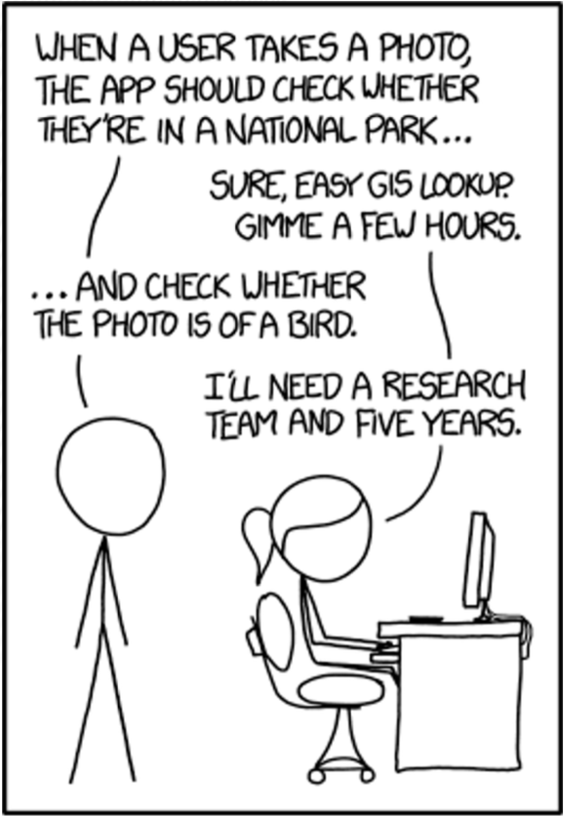
Artificial intelligence (AI) and Machine Learning (ML) in software Development
Introduction to AI and ML in Software Development
In 2014 - most AI tasks used to take 5 years and a research team to accomplish…
In 2024 - you just need API docs, a spare afternoon, and hopefully this lecture…

Slide 20
Artificial intelligence (AI) and Machine Learning (ML) in software Development
Introduction to AI and ML in Software Development
Artificial Intelligence (AI) and Machine Learning (ML) have become integral to modern software development, enhancing productivity, improving code quality, and enabling data-driven decision-making. By automating repetitive tasks, providing intelligent insights, and predicting potential issues, AI/ML technologies empower software engineers to focus on innovation and complex problem-solving.
Key Concepts:
Artificial Intelligence (AI): The simulation of human intelligence processes by machines, especially computer systems, including learning, reasoning, and self-correction.
Machine Learning (ML): A subset of AI that involves the use of algorithms and statistical models to enable computers to perform tasks without explicit instructions, relying on patterns and inference instead.
Applications in Software Development: Enhancing coding efficiency, automating testing and debugging, predicting project outcomes, and more.

Slide 21
Artificial intelligence (AI) and Machine Learning (ML) in software Development
Applications of AI/ML in Software Development
Code Completion and Suggestions. Examples: GitHub Copilot, TabNine
Automated Bug Detection. Examples: DeepCode (now Snyk Code), SonarQube
Predictive Analytics for Project Timelines. Examples: Microsoft Project with AI Integration, Atlassian’s Jira with Predictive Analytics Plugins

Slide 22
Artificial intelligence (AI) and Machine Learning (ML) in software Development
Tools and Frameworks for AI/ML in Software Development
TensorFlow: TensorFlow is an open-source machine learning framework developed by Google. It provides a comprehensive ecosystem for building and deploying ML models, supporting both research and production environments. TensorFlow is known for its flexibility, scalability, and extensive community support.
PyTorch: PyTorch is an open-source ML framework developed by Facebook's AI Research lab. It emphasizes flexibility and ease of use, making it a favorite among researchers and developers for prototyping and deploying deep learning models. PyTorch supports dynamic computation graphs, which allows for more intuitive model development.

Slide 23
Blockchain Technology and Its Applications
Introduction to Blockchain Technology
Blockchain technology has emerged as a transformative force in various industries, offering decentralized and secure methods for recording transactions and managing data
Originally conceptualized as the underlying technology for cryptocurrencies like Bitcoin, blockchain has found applications beyond digital currencies, including supply chain management, healthcare, finance, and more.
Key Concepts:
Definition: A blockchain is a distributed ledger technology that records transactions across multiple computers so that the record cannot be altered retroactively without the alteration of all subsequent blocks
Components: Blocks, chains, nodes, consensus mechanisms, cryptographic hashing
Benefits: Enhanced security, transparency, reduced fraud, decentralization, and increased efficiency

Slide 24
Blockchain Technology and Its Applications
Principles of Blockchain: Decentralization
Decentralization refers to the distribution of authority, control, and data across a network rather than being held by a single central entity. In a decentralized blockchain network, multiple nodes (computers) participate in validating and recording transactions, ensuring no single point of failure or control.
Key Features:
Distributed Ledger: Each node maintains a copy of the entire blockchain, promoting redundancy and resilience.
Peer-to-Peer Network: Direct interactions between nodes without intermediaries.
Consensus Mechanisms: Protocols like Proof of Work (PoW) or Proof of Stake (PoS) ensure agreement on the state of the blockchain.
Benefits:
Resilience: Reduced vulnerability to attacks or failures affecting the entire network.
Transparency: All participants can access and verify the data independently.
Trust: Eliminates the need for a central authority, fostering trust through consensus.

Slide 25
Blockchain Technology and Its Applications
Principles of Blockchain: Immutability
Immutability ensures that once data is recorded on the blockchain, it cannot be altered or deleted. This property is achieved through cryptographic hashing and the chaining of blocks, where each block references the previous one, creating a secure and tamper-evident ledger.
Key Features:
Cryptographic Hashing: Each block contains a hash of the previous block, linking them securely.
Consensus Validation: Altering any block would require redoing the consensus process for all subsequent blocks, which is computationally infeasible.
Permanent Record: Provides a reliable and unchangeable history of transactions.
Benefits:
Data Integrity: Guarantees that the recorded data remains accurate and unaltered.
Accountability: Enhances traceability and accountability by maintaining a verifiable history.
Security: Protects against unauthorized modifications and fraudulent activities.

Slide 26
Blockchain Technology and Its Applications
Principles of Blockchain: Transparency
Transparency in blockchain refers to the visibility of transactions and data to all participants within the network. While blockchain ensures that data is accessible, it also maintains privacy through pseudonymous or anonymous identities, depending on the blockchain implementation.
Key Features:
Public Ledger: All transactions are recorded on a public ledger accessible to network participants.
Auditability: Participants can independently verify and audit transactions.
Consensus Visibility: The process of reaching consensus is open and transparent to all nodes.
Benefits:
Trust Building: Enhances trust among participants by providing visibility into transactions.
Reduced Fraud: Makes fraudulent activities more detectable and preventable.
Enhanced Collaboration: Facilitates collaboration by providing a shared and transparent data source.

Slide 27
Blockchain Technology and Its Applications
Use cases of blockchain technology
Smart Contracts: Smart contracts are self-executing contracts with the terms of the agreement directly written into code. They automatically enforce and execute the terms when predefined conditions are met, eliminating the need for intermediaries. Examples: Ethereum, Hyperledger Fabric
Decentralized Applications (dApps): Decentralized Applications (dApps) are applications that run on a blockchain network rather than a centralized server. They leverage smart contracts to provide backend services and ensure decentralization, transparency, and security. Examples: Uniswap, CryptoKitties

Slide 28
Quantum Computing Basics
Introduction to quantum computing
Quantum Computing is an emerging field that leverages the principles of quantum mechanics to perform computations far more efficiently than classical computers for certain tasks.
While still in its infancy, quantum computing promises to revolutionize various domains, including software engineering, cryptography, optimization, and the simulation of complex systems.
Key Concepts:
Quantum vs. Classical Computing: Understanding the fundamental differences in computation paradigms.
Current State of Quantum Computing: Overview of existing quantum computers and ongoing research.
Relevance to Software Engineering: How quantum computing intersects with software development and engineering practices.

Slide 29
Quantum Computing Basics
Quantum mechanics principles: Qubits
A qubit (quantum bit) is the fundamental unit of quantum information, analogous to the classical bit but with unique properties that enable quantum computation.
Key Features:
Binary States: Like classical bits, qubits can represent 0 or 1.
Quantum States: Qubits can exist in a combination of states simultaneously due to superposition.
Mathematical Representation:
A qubit state can be represented as |ψ⟩ = α|0⟩ + β|1⟩, where α and β are complex numbers satisfying |α|² + |β|² = 1.

Slide 30
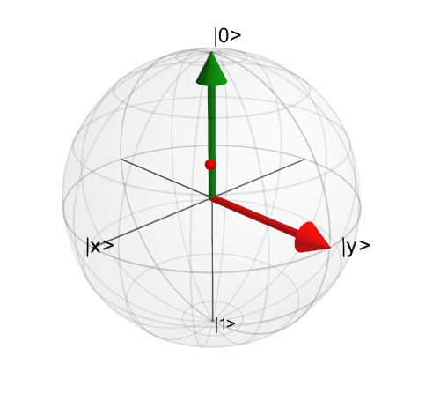
Quantum Computing Basics
Quantum mechanics principles: Superposition
Superposition is a fundamental principle of quantum mechanics where a quantum system can exist in multiple states simultaneously until it is measured.
Key Features:
Multiple States: A qubit can be in a linear combination of |0⟩ and |1⟩ states.
Probability Amplitudes: The coefficients (α and β) determine the probability of measuring each state.
Visualization:
The Bloch Sphere is a graphical representation of a qubit's state, illustrating superposition and phase relationships.

Slide 31
Quantum Computing Basics
Quantum mechanics principles: Entanglement
Entanglement is a quantum phenomenon where two or more qubits become interconnected such that the state of one qubit instantly influences the state of the other, regardless of the distance separating them.
Key Features:
Non-Classical Correlations: Entangled qubits exhibit correlations that cannot be explained by classical physics.
Quantum Information Sharing: Entanglement is essential for quantum communication and certain quantum algorithms.
Example:
Bell States are specific examples of maximally entangled two-qubit states, such as |Φ⁺⟩ = (|00⟩ + |11⟩)/√2.

Slide 32
summary
The trends that have an effect on software engineering technology often come from business, organizational, market, and cultural arenas
These “soft trends” can guide the direction of research and the technology that is derived as a consequence of research
It is likely that artificial intelligence and data science methods will continue to impact all aspects of software engineering

Slide 33
References
Titus Winters, Tom Manshreck, and Hyrum Wright. (2020). Software Engineering at Google: Lesson Learned from Programming Over Time. 1st. O’Reilly Media. California. ISBN: 978-1492082798.
Roger Pressman and Bruce Maxim. (2020). Software Engineering: A Practitioner's Approach. 9th. McGraw Hill. New York. ISBN: 978-1259872976.
Ian Sommerville. (2016). Software Engineering. 10th. Pearson. London. ISBN: 978-1-292-09613-1.

